Slide 1
Matrix Factorization
Presenter : 盧德晏
Advisor : 丁建均 教授

Slide 2
Pipeline
Method for different matrix decomposition
$$A=SDS^{−1}$$
$$A_{n×n},S_{n×n},D_{n×n}$$
Eigenvector decomposition
Principle component analysis
(PCA)
$$A=WX$$
$$A_{F×N},W_{F×K},X_{K×N}$$
Matrix
factorization
Fast algorithm:
Cholesky decomposition, LU, etc…
Cholesky : $A=LL^{H}$ , $A_{n×n},L_{n×n}$
LU : $A=LU$ , $A_{n×n},L_{n×n}$, $U_{n×n}$
Singular value decomposition
(SVD)
$A=UΣV^{H}$ ,
$$A_{m×n},U_{m×m},Σ_{m×n},V_{n×n}$$
Negative matrix decomposition
(NMD)
$A=WH$, $W,H≥0$
$$A_{F×N},W_{F×K},H_{K×N}$$

Slide 3
Matrix Factorization
Irreducible matrix & reducible matrix
<Thm 1>: Reducible matrix ${\text{A} }_{n×n}$
If $∃P$ and $P^{T}=P^{−1}$, s.t. $P^{T}AP=\left[\begin{matrix}B & C \\ O & D\end{matrix}\right]$ , where $B_{r×r}$ , $r≥1$ and ${D }_{(n−r)×(n−r)}$
, then ${\text{A} }_{n×n}$ is a reducible matrix
<Thm 2>: Strongly connected graph
${\text{A} }_{n×n}$ is a irreducible matrix iff its directed graph is strongly connected graph.
$\text{A}=\left[\begin{matrix}0 & a_{12} & 0 & 0 & 0 \\ 0 & 0 & a_{23} & 0 & 0 \\ a_{31} & 0 & 0 & 0 & 0 \\ 0 & 0 & 0 & 0 & a_{45} \\ 0 & 0 & 0 & a_{54} & 0\end{matrix}\right]$ ----- reducible
$a_{12}≠0 ;a_{23}≠0$ ; $a_{31}≠0$ ; $a_{45}≠0$ ; $a_{54}≠0$
$\text{A}=\left[\begin{matrix}0 & a_{12} & 0 \\ 0 & 0 & a_{23} \\ a_{31} & 0 & 0\end{matrix}\right]$ ----- irreducible
$a_{12}≠0 ;a_{23}≠0$ ; $a_{31}≠0$
$$a_{12}$$
1
2
$$a_{12}$$
$$a_{24}$$
1
2
4
Strongly connected
$$a_{45}$$
$$a_{54}$$
Weakly connected
$$a_{31}$$
$$a_{23}$$
$$a_{31}$$
$$a_{23}$$
3
5
3

Slide 4
Matrix Factorization
Perron-Frobenius Theorem :
$A=[a_{ij}]$with the size $m×n$ is a non-negative matrix if
Irreducible matrix
$a_{ij}≥0$, $∀_{i=1,2,…,m ; j=1,2,…,n}$
Radius of spectrum : $ρ\left(A\right)=\max\left(\left|λ\right|\right)>0$
$∃_{x>0}$, s.t. $Ax=ρ\left(A\right)x$ and ${\left\|x\right\|}_{1}=1$
Eigenvector $x$corresponding to its eigenvalue $λ$ is a non-negative vector

Slide 5
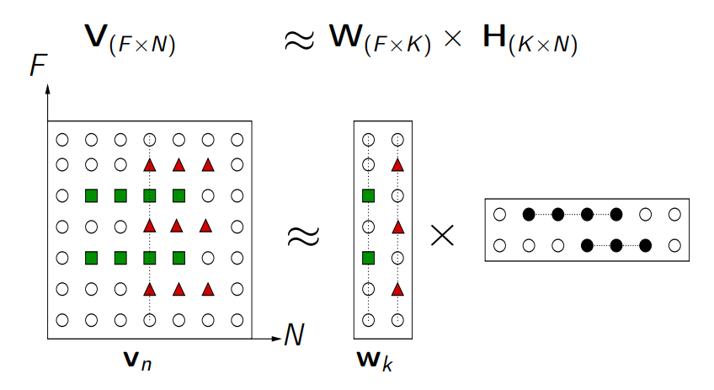
Matrix Factorization
Data matrix : $V_{F×N}$, each column vector represents each data.
Basis (Dictionary, Patterns) : $W_{F×N}$, each column vector represents a basis.
Regressors (activation coefficients) : $H_{F×N}$, each column vector represents the coefficients

Slide 6
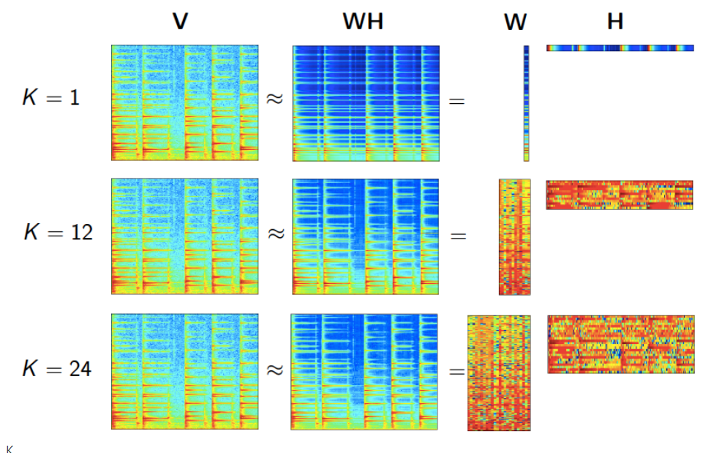
Matrix Factorization
How to choose the dimension K : $V_{F×N}≅W_{F×K}H_{K×N}$
Data fitting
A great $K$ leads to a better data
approximation.
Model complexity
A smaller $K$ leads to a less complex
model (easier to estimate,
less parameters to transmit)

Slide 7
Matrix Factorization
Why do we use non-negative decomposition for optimized problem ?
Data is often non-negative by nature
Pixel intensities
Amplitude spectra
Occurrence counts
Energy consumption
Users scores
Stock market values

Slide 8
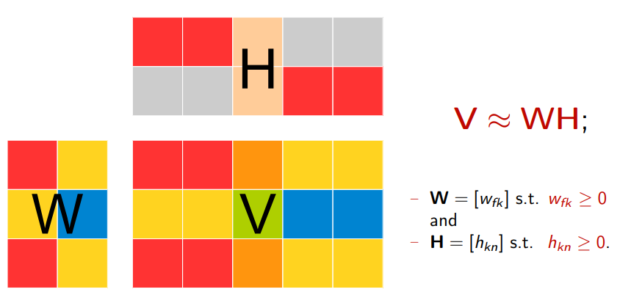
Non-negative matrix decomposition
Optimized problem for NMD :

Slide 9
Non-negative matrix decomposition
Criteria: Similarity between true data $V$ and estimated data $WH$
$$\min_{W,H>0}{D\left(V|WH\right)}$$
where $D\left(V|WH\right)=\sum_{i}{\sum_{j}{d\left(V_{ij}|{\left(WH\right)}_{ij}\right)}}$
$d\left(x|y\right)$ is a scalar divergence which satisfies the following rule :
$d\left(x|y\right)$ is continuous over $x$ and $y$
$d\left(x|y\right)≥0$ , $∀_{x,y≥0}$
$d\left(x|y\right)=0$ if $x=y$

Slide 10
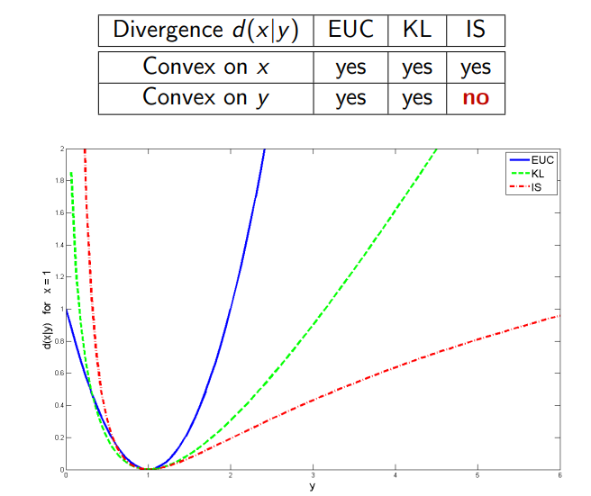
Non-negative matrix decomposition
NMD : $V≈WH$, $W≥0 ,H≥0$
Euclidean norm:
$D_{EUC}\left(V||WH\right)={\left\|V−WH\right\|}^{2}=\sum_{i}{\sum_{j}{{\left(V_{ij}−{\left(WH\right)}_{ij}\right)}^{2}}}$
$D_{EUC}\left(λx||λy\right)=λ^{2}D_{EUC}\left(x||y\right)$
Kullback-leibler divergence:
$D_{KL}\left(V||WH\right)=\sum_{i}{\sum_{j}{V_{ij}\log\left(\frac{V_{ij}}{{\left(WH\right)}_{ij}}\right)}}−\left(V_{ij}−{\left(WH\right)}_{ij}\right)$
$D_{KL}\left(λx||λy\right)=λD_{KL}\left(x||y\right)$
Itakura-Saito divergence:
$D_{IS}\left(V||WH\right)=\sum_{i}{\sum_{j}{\frac{V_{ij}}{{\left(WH\right)}_{ij}}}}−\log\left(\frac{V_{ij}}{{\left(WH\right)}_{ij}}\right)−1$
$D_{IS}\left(λx||λy\right)=D_{IS}\left(x||y\right)$ ------ scale-invariant
it provides higher accuracy in the representation of data
with large dynamic range, such as audio spectra.

Slide 11
Non-negative matrix decomposition
Question : Which divergence to choose ?
by intuition or from some prior knowledge of the application goal (e.g., NMF is used for predicting the unseen data while minimizing the mean squared error = EUC distance) or invariances (e.g., scale invariance for music analysis with IS divergence)
from some probabilistic considerations.
optimize the divergence (e.g. from some parametric family) on some development data within a particular application.

Slide 12
Non-negative matrix decomposition
Statistical viewpoint :
For many divergences a probabilistic formulation is possible: the divergence
minimization becomes to a maximum likelihood (ML) criterion
$D\left(V||\hat{V}\right)=−\log\left(p\left(V|\hat{V}\right)\right)+c$ , $\hat{V}=WH$
 | Divergence $D\left(V||\hat{V}\right)$ | Probability distribution | PDF $p\left(V|\hat{V}\right)$
Euclidean norm | $$\sum_{i}{\sum_{j}{{\left(V_{ij}−{\hat{V}}_{ij}\right)}^{2}}}$$ | $$V_{ij}\sim Gaussian\left({\hat{V}}_{ij},σ^{2}\right)$$ | $$\prod_{i,j}{\frac{1}{\sqrt{2πσ^{2}}}e^{−\frac{{\left(V_{ij}−{\hat{V}}_{ij}\right)}^{2}}{2σ^{2}}}}$$
Kullback-leibler divergence | $$\sum_{i}{\sum_{j}{V_{ij}\log\left(\frac{V_{ij}}{{\left(WH\right)}_{ij}}\right)}}−\left(V_{ij}−{\left(WH\right)}_{ij}\right)$$ | $$V_{ij}\sim Poisson\left({\hat{V}}_{ij}\right)$$ | $$\prod_{i,j}{\frac{1}{Γ\left(V_{ij}+1\right)}{{\hat{V}}_{ij}}^{V_{ij}}e^{−{\hat{V}}_{ij}}}$$
Itakura-Saito divergence | $$\sum_{i}{\sum_{j}{\frac{V_{ij}}{{\left(WH\right)}_{ij}}}}−\log\left(\frac{V_{ij}}{{\left(WH\right)}_{ij}}\right)−1$$ | $$V_{ij}\sim Exponential\left(\frac{1}{{\hat{V}}_{ij}}\right)$$ | $$\prod_{i,j}{\frac{1}{{\hat{V}}_{ij}}e^{−\frac{V_{ij}}{{\hat{V}}_{ij}}}}$$

Slide 13
PCA vs NMD
Principle component analysis (PCA): For the view of maximum variance
$N$ data points : $x_{1}$, $x_{1}$,…, $x_{N}$ ; $x_{i}∈ℝ^{D}, ∀_{i=1,2,…,N}$
How to find a projection vector $v∈ℝ^{D}$ , $v ≠0$ such that the variance of data $Σ$ is
maximized ?
$Var\left(v^{T}x\right)=𝔼\left[\left(v^{T}x−v^{T}μ_{x}\right){\left(v^{T}x−v^{T}μ_{x}\right)}^{T}\right]=𝔼\left[v^{T}(x−μ_{x}) {(x−μ_{x})}^{T}v\right]=v^{T}R_{x}v$
Optimized problem:
$$\max_{v}{v^{T}R_{x}v}$$
subjected to $v^{T}v=1$
By Lagrange multiplier :
$ℒ=v^{T}R_{x}v−λ(v^{T}v−1)$ and let $\frac{∂ℒ}{∂v}=0$
$→$ $2R_{x}v−2λv=0$ $→$ $R_{x}v=λv$, $v ≠0$
$→ λ$ is eigenvalue of the auto-correlation matrix $R_{x}$ in corresponding to its eigenvector $v$
Small
variance
$$v_{o}$$
$$x_{2}$$
$$x_{1}$$
$$x_{3}$$
$$v$$
Large variance

Slide 14
PCA vs NMD
Principle component analysis (PCA): For the view of minimum square error
$N$ original data points : $x_{1}$, $x_{1}$,…, $x_{N}$ ; $x_{i}∈ℝ^{D}, ∀_{i=1,2,…,N}$
$N$ reconstructed data points :$\tilde{x_{1}}$,$\tilde{x_{2}}$,…,$\tilde{x_{N}}$; $\tilde{x_{i}}∈ℝ^{D}, ∀_{i=1,2,…,N}$
Reconstruction error $E=\frac{1}{N}\sum_{i=1}^{N}{{\left\|x_{i}−\tilde{x_{i}}\right\|}^{2}}$
Our goal : Dimension reduction and less distortion of reconstruction.
$\tilde{x_{i}}≈\sum_{k=1}^{D}{{α_{i,k}w}_{k}}$ , where $α_{i,k}={x_{i}}^{T}w_{k}$ , $w_{k}$ is an orthonormal basis.
$$\min_{w}{\frac{1}{N}\sum_{i=1}^{N}{{\left\|x_{i}−\tilde{x_{i}}\right\|}^{2}}}$$
subjected to ${w_{i}}^{T}w_{j}=δ_{i,j}$
The solution is $R_{x}w_{i}=λ_{i}w_{i}$ ,$w_{i}≠0$

Slide 15
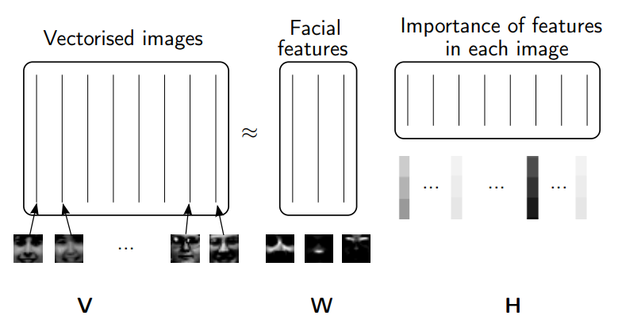
Application
Face recognition

Slide 16
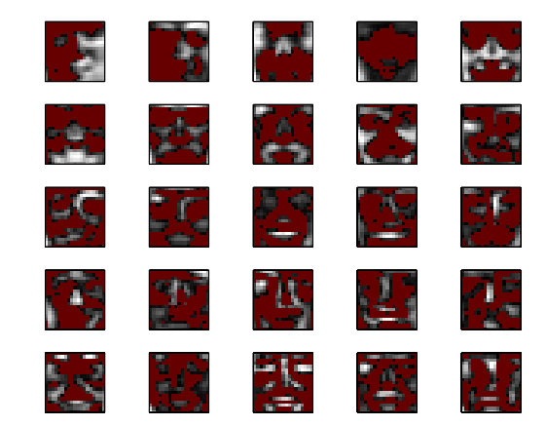
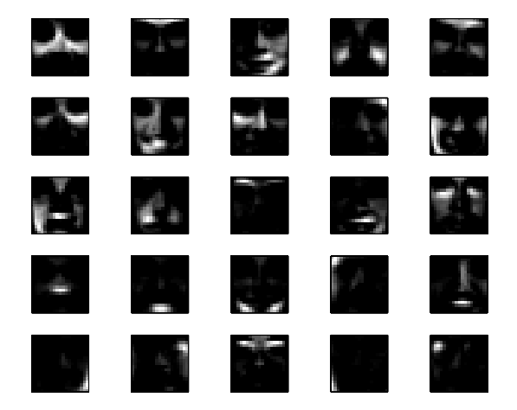
Application
Face recognition
PCA
NMD

Slide 17
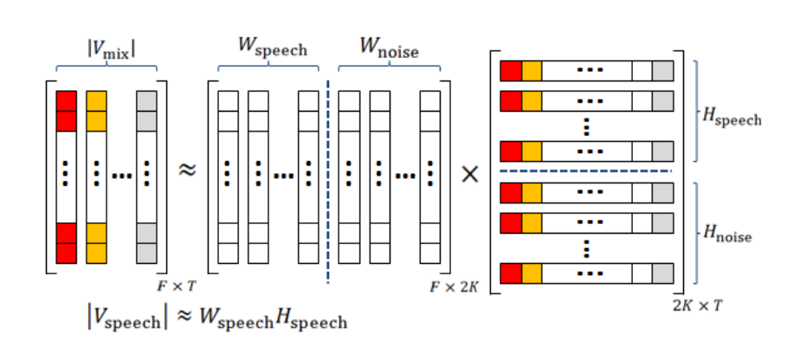
Application
Application : Denoising

Slide 18
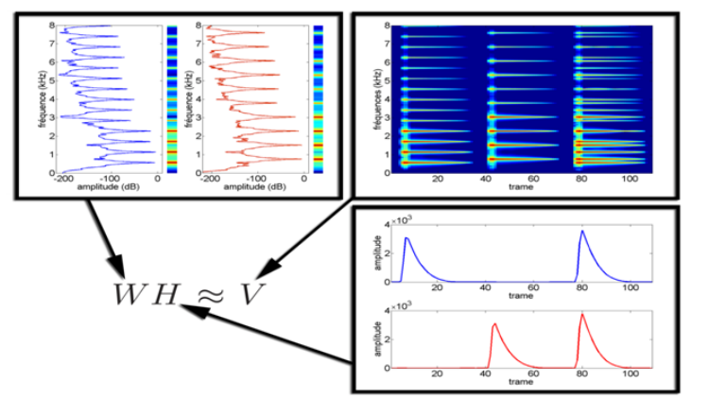
Application
Application : Speech Processing

Slide 19
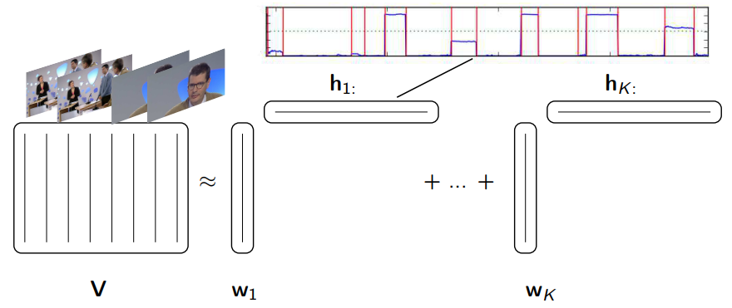
Application
Application: Temporal segmentation can be achieved by thresholding the temporal activations relating to components of interest

Slide 20
Reference
Kejun Huang, Nicholas D.Sidiropoulos, and Ananthram Swami, “Non-negative matrix
factorization revisited: unique and algorithm for symmetry decomposition,” IEEE Trans. on
Signal Proc. vol.62, issue 1, pp.211-224, Oct, 2013.
Slim ESSID & Alexey OZEROV, “NMF tutorial,” Telecom. ParisTech, July, 2014.
Jimmy Lude˜na-Choez and Ascensi´on Gallardo-Antol´ın, “Speech denoising using non-
negative matrix factorization with kullback-leibler divergence and sparseness constraints,”
Comm. in Computer and Information Science. Pp.207-216, Nov. 2012.
Daniel D.Lee, and H.Sebastian Seung, “Algorithm for non-negative matrix factorization,”
NIPS, 2000
Tommy Huang, “機器/統計學習:主成分分析(Principal Component Analysis, PCA)
,” Medium, Apr, 2018.

